Slide 1
Chapter 9: Morphological Image Processing (Digital Image Processing – Gonzalez/Woods)
In form and in feature, face and limb,
I grew so like my brother
That folks got taking me for him
And each for one another.
Henry Sambrooke Leigh, Carols of Cockayne, The Twins

Slide 2
Morphology
Morphology -“shape” feature
Morphology relates to the “shape” of a connected component.
Morphological image processing (or morphology) refers to a range of image processing techniques that deal with the shape (or morphology) of objects in an image.
Morphological operations are typically applied to remove imperfections. .

Slide 3
Use of Mathematical Morphology
Mathematical morphology is used in the following application:
Image enhancement
Image segmentation
Image restoration
Edge and feature detection
Texture analysis
Feature generation
Skeletonization
Shape analysis
Image compression
Component analysis
Curve filling
Noise reduction

Slide 4
9.1 Basic Concepts in Set Theory
Subset
Union
Intersection
disjoint / mutually exclusive
Complement
Difference
Reflection
Translation

Slide 5
Logic Operations Involving Binary Pixels and Images
The principal logic operations used in image processing
are: AND, OR, NOT (COMPLEMENT).
These operations are functionally complete.
Logic operations are preformed on a pixel by pixel basis between corresponding pixels (bitwise).
Other important logic operations :
XOR (exclusive OR), NAND (NOT-AND)
Logic operations are just a private case for a binary set operations, such : AND – Intersection , OR – Union,
NOT-Complement.

Slide 6
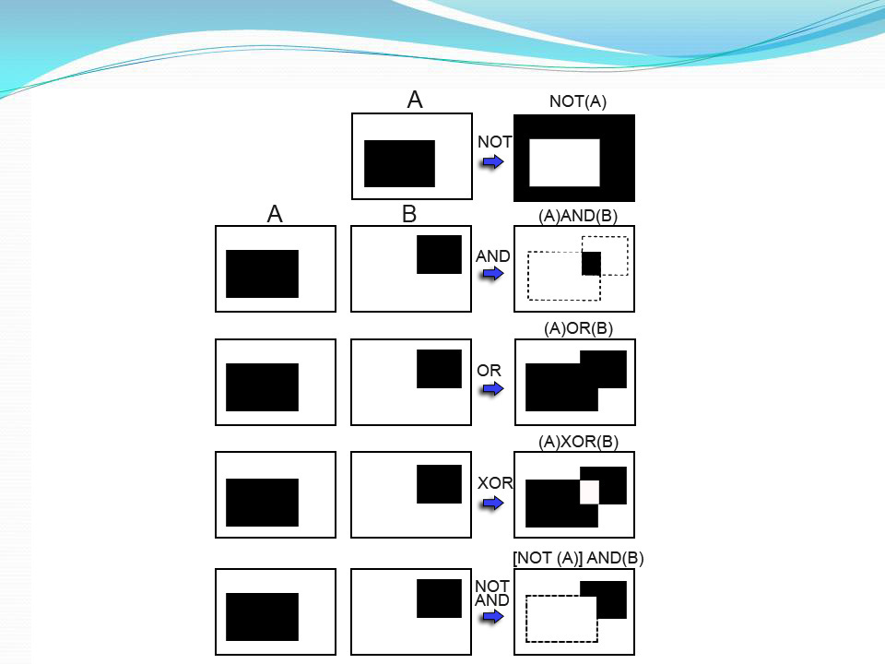

Slide 7
Dilation
Used to increase the area of a component.
Adds pixels around the boundaries
fills interior holes
An image is processed by applying a structuring element
center the structuring element S on pixel P
if P is OFF then set it to ON if any part of S overlaps an ON image pixel
This process can only turn pixels from OFF to ON
The component can only grow

Slide 8
9.2.1 Dilation
Dilation is used for expanding an element A by using structuring element B
Dilation of A by B and is defined by the following equation:
This equation is based 0n obtaining the reflection 0f B
about its origin and shifting this reflection by z.
The dilation of A by B is the set of all displacements z,
such that and A overlap by at least one element. Based
On this interpretation the equation of (9.2-1) can be
rewritten as:

Slide 9
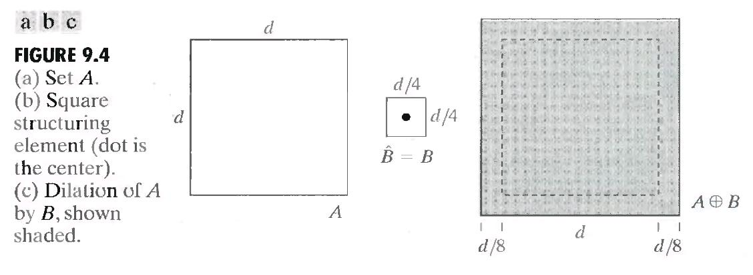
9.2.1 Dilation – Example 1

Slide 10
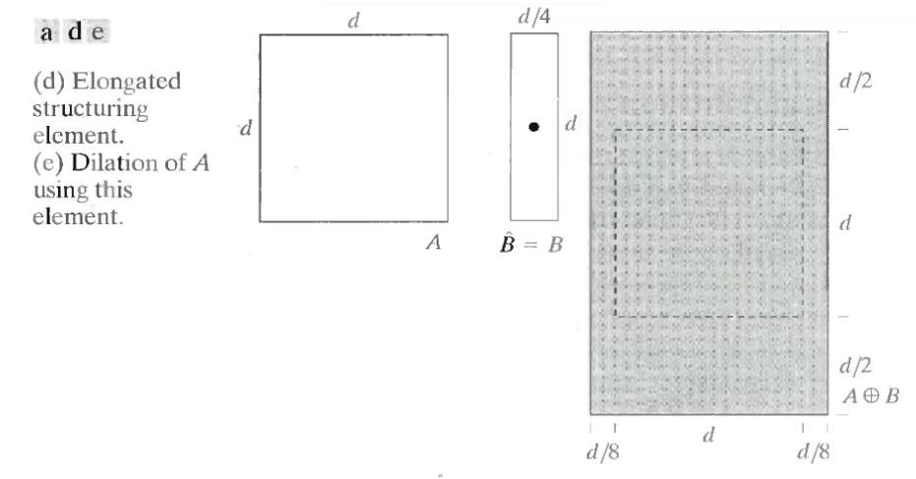
9.2.1 Dilation – Example 2

Slide 11
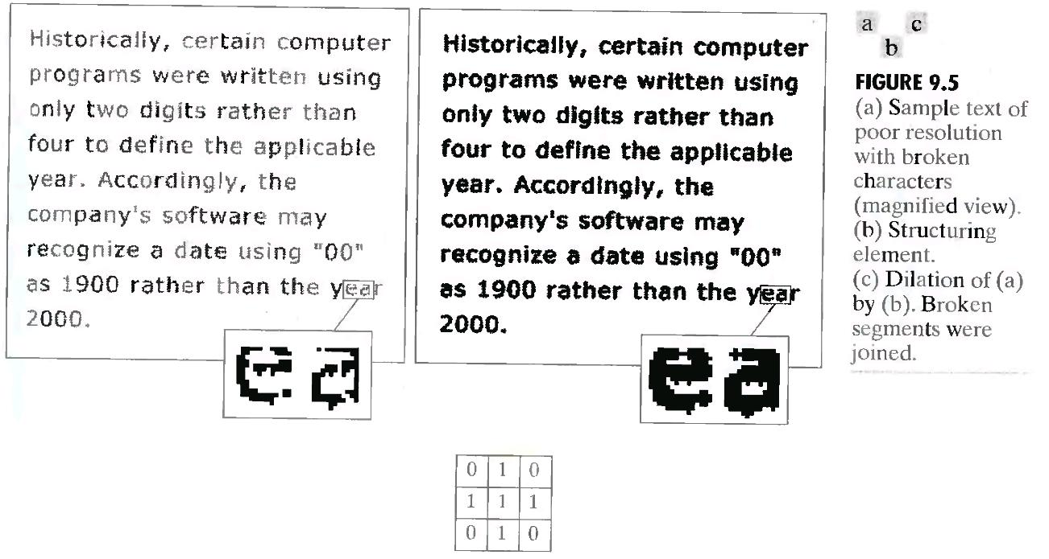
9.2.1 Dilation – A More interesting Example

Slide 12
Erosion
Used to decrease the area of a component.
Removes pixels around the boundaries
Enlarges interior holes
An image is processed by applying a structuring element
center the structuring element S on pixel P
if P is ON then set it to OFF if any part of S overlaps an OFF image pixel
This process can only turn pixels from ON to OFF
The component can only shrink

Slide 13
9.2.2 Erosion
Erosion is used for shrinking of element A by using element B
Erosion for Sets A and B in Z², is defined by the
following equation:
This equation indicates that the erosion of A by B is the set of all points z such that B, translated by z, is combined in A.

Slide 14
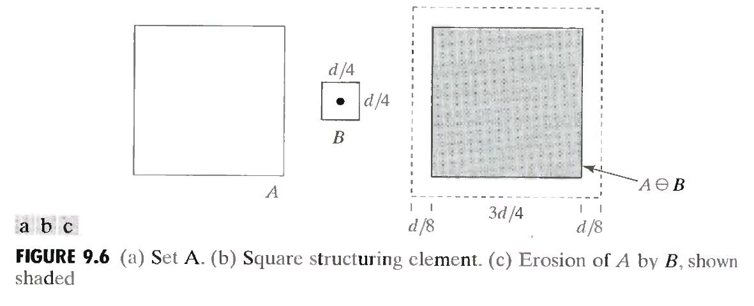
9.2.2 Erosion – Example 1

Slide 15
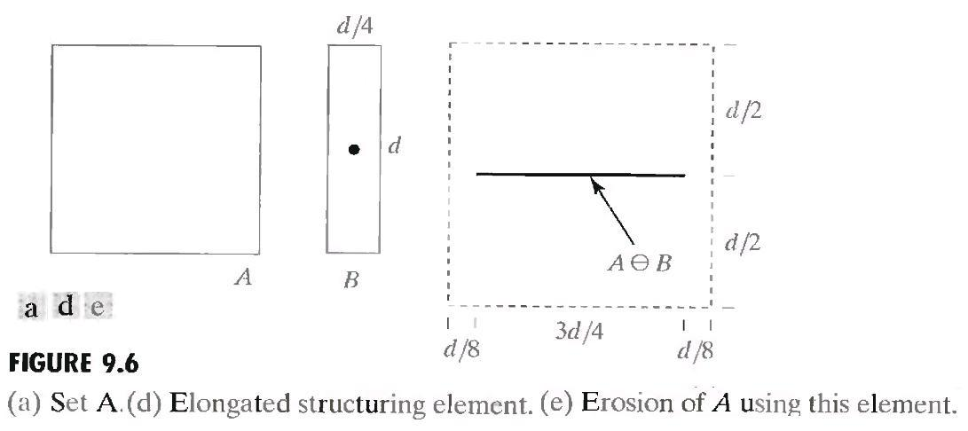
9.2.2 Erosion – Example 2

Slide 16

Duality between dilation and erosion
Dilation and erosion are duals of each other with respect to set complementation and reflection. That is,
One of the simplest uses of erosion is for eliminating irrelevant details (in terms of size) from a binary image.

Slide 17
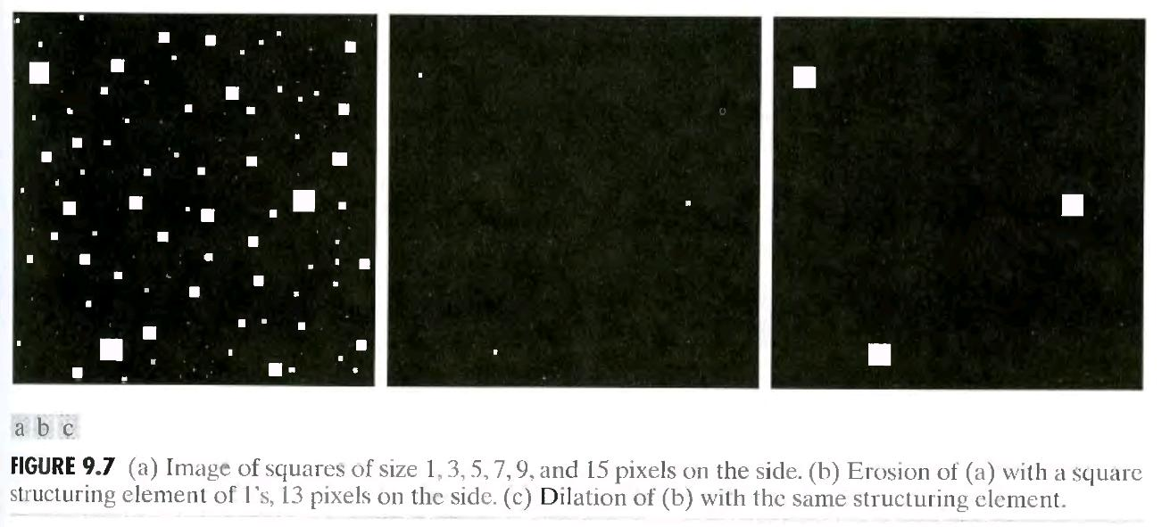
Erosion and Dilation summary

Slide 18
Opening and Closing Operations
The open operation is defined as a erosion followed by an dilation that
smoothens boundaries
enlarges narrow gaps
eliminates “spikes”
The opening of image f by structuring element s, denoted f ○ s is simply an erosion f by s
followed by the dilation of the result by s. This operation may be written as:
f ○ s = (f s) s
where and denote erosion and dilation, respectively.

Slide 19
Opening and Closing Operations
The close operation is defined as an erosion followed by a dilation that
fills narrow gaps
eliminates small holes and breaks.
Repeated applications of either “open” or “close” have no effect
The closing of image f by structuring element s, denoted f • s is simply dilation of f by s, followed by the erosion of the result by s.Closing operation may be defined by the following expression:
f • s = (f s) s
Together with closing, the opening serves in computer vision and image processing as a basic workhorse of morphological noise removal. Opening removes small objects from the foreground of an image, placing them in the background, while closing removes small holes in the foreground, changing small islands of background into foreground.

Slide 20
9.3 Opening And Closing
Opening – smoothes contours of an object, break narrow isthmuses , eliminates thin protrusions
Closing – smoothes sections of contours, fuses narrow breaks and long thin gulfs, eliminates small holes and fills gaps in contours
These operations are can be applied few times, but has effect only once

Slide 21



9.3 Opening And Closing
Opening –
Erode A by B, and then dilate the result by B

Slide 22
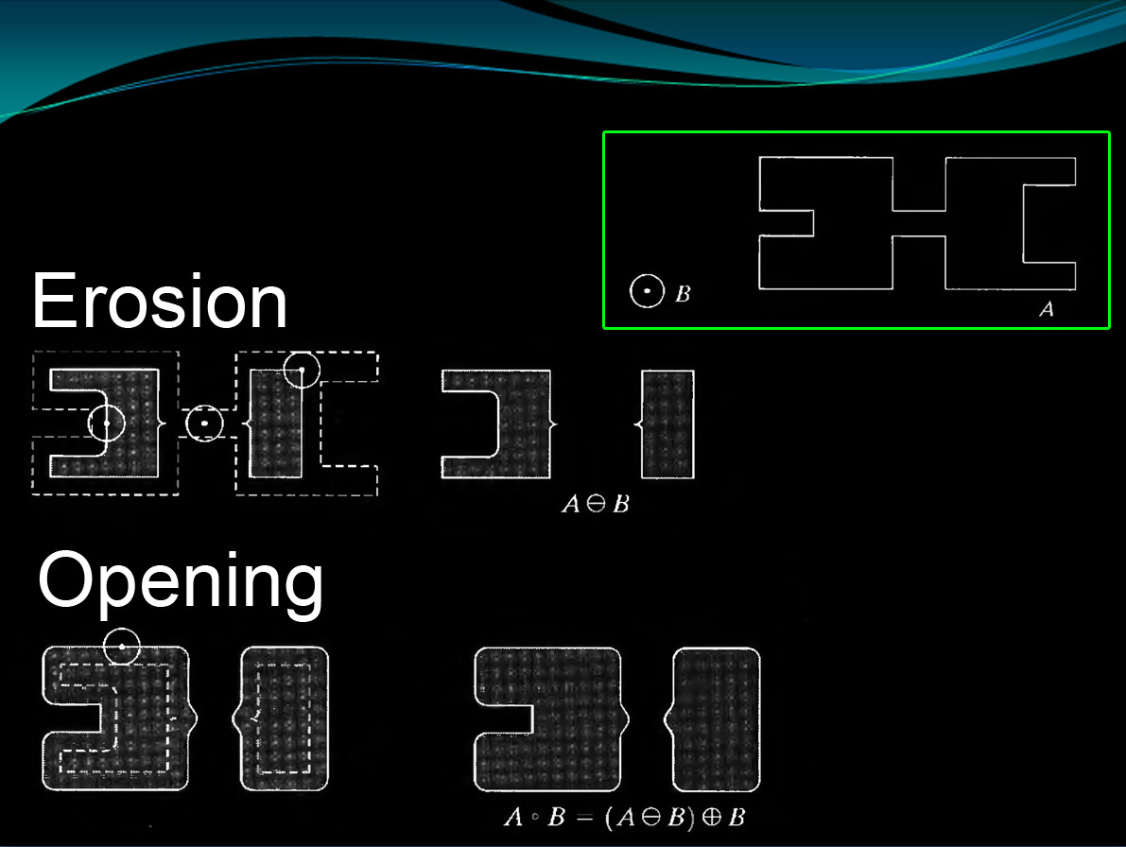

Slide 23


9.3 Opening And Closing
Closing –
First – dilate A by B, and then erode the result by B
In other words, closing is the group of points, which the intersection of object B around them with object A – is not empty

Slide 24
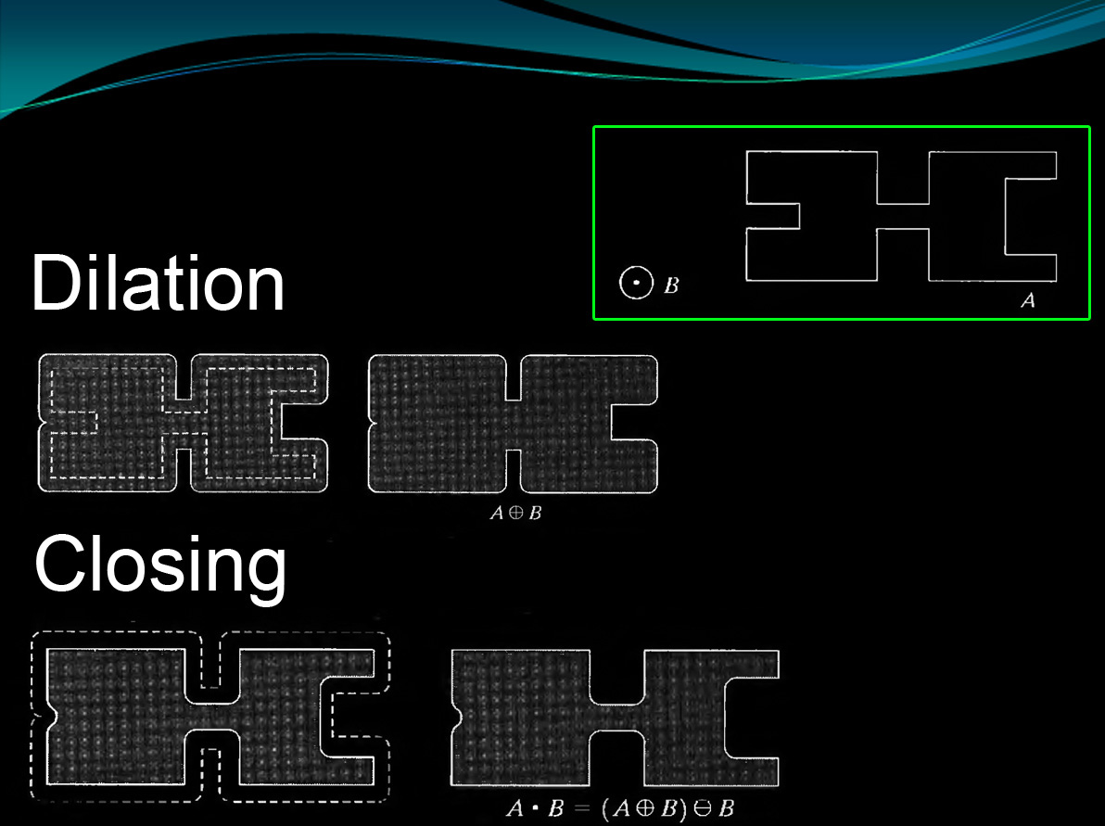

Slide 25
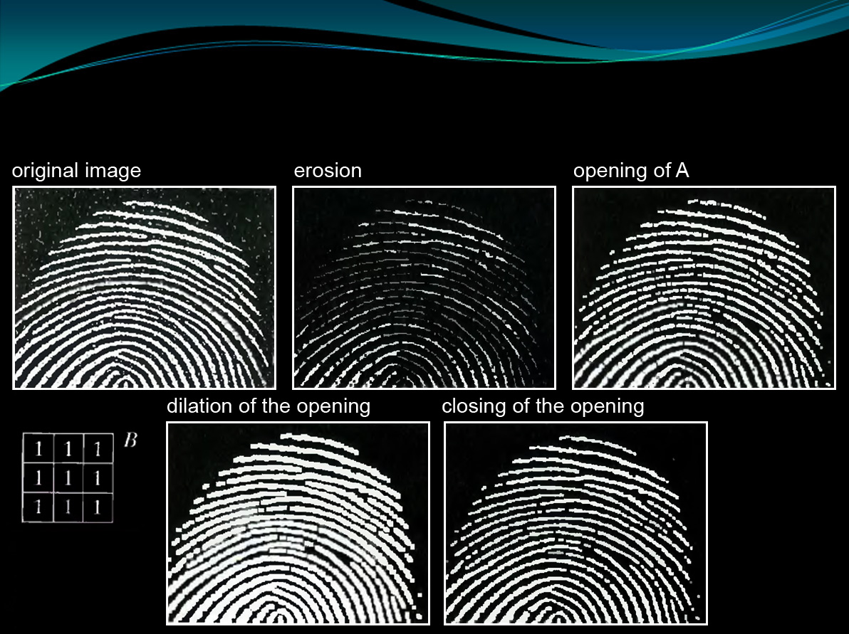
Use of opening and closing for morphological filtering

Slide 26
9.4 The Hit-or-Miss Transformation
A basic morphological tool for shape detection.
Let the origin of each shape be located at its center of gravity.
If we want to find the location of a shape , say – X ,
at (larger) image, say – A :
Let X be enclosed by a small window, say – W.
The local background of X with respect to W is defined as the set difference (W - X).
Apply erosion operator of A by X, will get us the set of locations of the origin of X, such that X is completely contained in A.
It may be also view geometrically as the set of all locations of the origin of X at which X found a match (hit) in A.

Slide 27
9.4 The Hit-or-Miss Transformation
Cont.
Apply erosion operator on the complement of A by the local background set (W – X).
Notice, that the set of locations for which X exactly fits inside A is the intersection of these two last operators above.
This intersection is precisely the location sought.
Formally:
If B denotes the set composed of X and it’s background –
B = (B1,B2) ; B1 = X , B2 = (W-X).
The match (or set of matches) of B in A, denoted is:

Slide 28
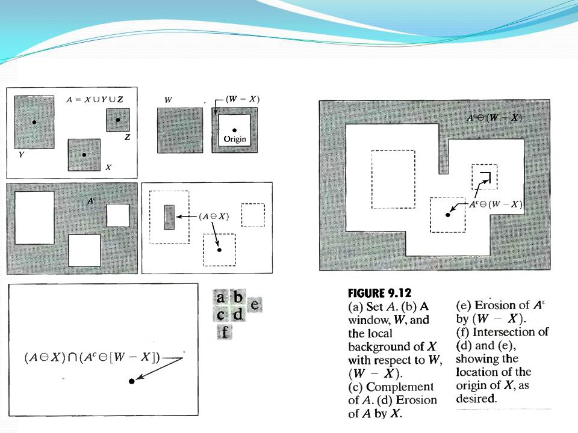
Hit-or-Miss exp:

Slide 29
9.4 The Hit-or-Miss Transformation
The reason for using these kind of structuring element – B = (B1,B2) is based on an assumed definition that,
two or more objects are distinct only if they are disjoint (disconnected) sets.
In some applications , we may interested in detecting certain patterns (combinations) of 1’s and 0’s. and not for detecting individual objects.
In this case a background is not required.
and the hit-or-miss transform reduces to simple erosion.
This simplified pattern detection scheme is used in some of the algorithms for – identifying characters within a text.

Slide 30
9.5 Basic Morphological Algorithms
1 – Boundary Extraction
2 – Region Filling
3 – Extraction of Connected Components
4 – Convex Hull
5 – Thinning
6 – Thickening
7 – Skeletons

Slide 31
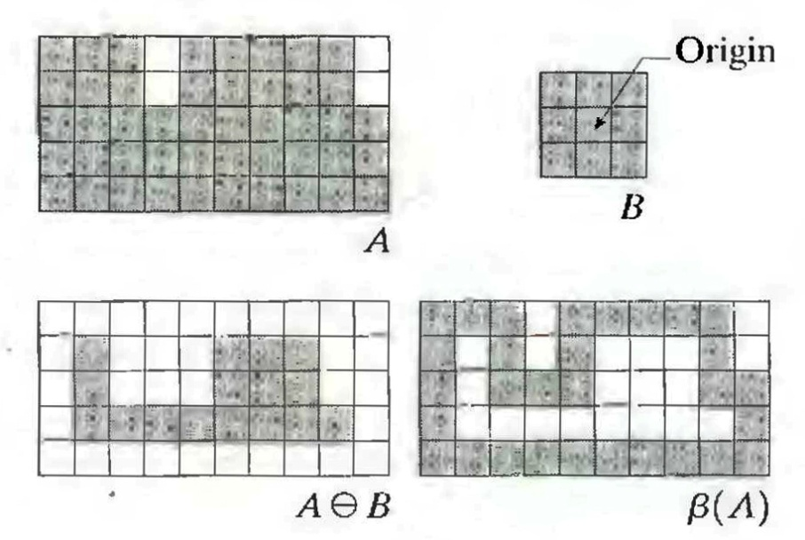

9.5.1 Boundary Extraction
First, erode A by B, then make set difference between A and the erosion.

Slide 32

9.5.1 Boundary Extraction

Slide 33
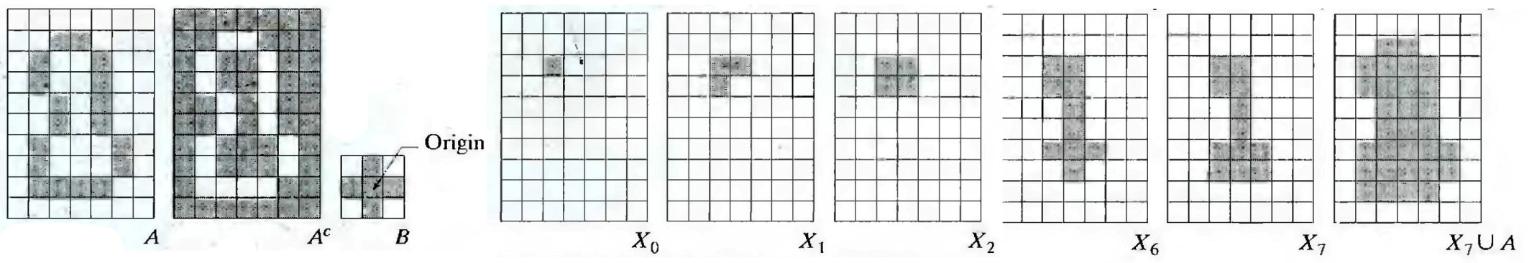
9.5.2 Region Filling
This algorithm is based on a set of dilations, complementation and intersections
p is the point inside the boundary, with the value of 1
X(k) = (X(k-1) xor B) conjunction with complemented A
The process stops when X(k) = X(k-1)
The result that given by union of A and X(k), is a set contains the filled set and the boundary

Slide 34


9.5.2 Region Filling

Slide 35
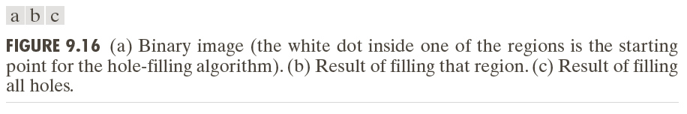

Slide 36
9.5.3 Extraction of Connected Components
This algorithm extracts a component by selecting a point on a binary object A
Works similar to region filling, but this time we use in the conjunction the object A, instead of it’s complement

Slide 37


9.5.3 Extraction of Connected Components

Slide 38
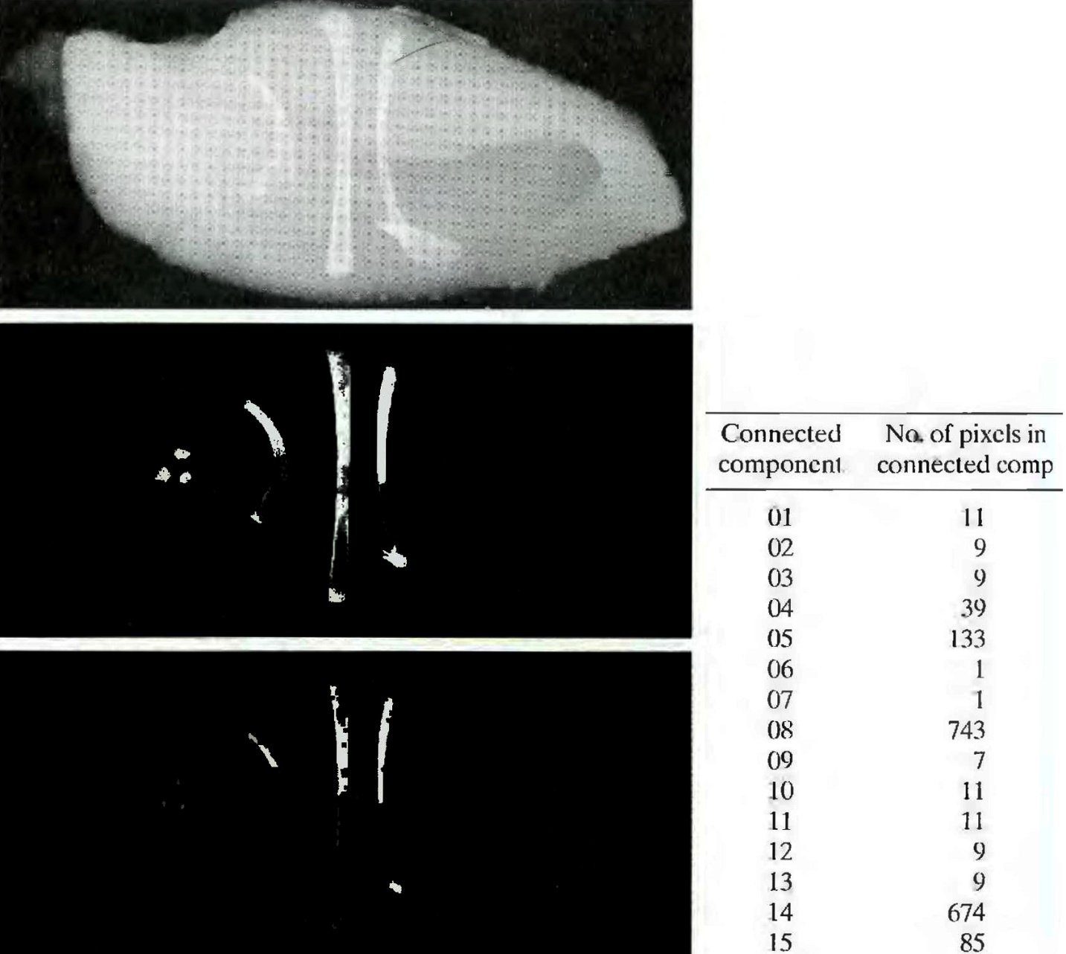
This shows automated inspection of chicken-breast, that contains bone fragment
The original image is thresholded
We can get by using this algorithm the number of pixels in each of the connected components
Now we could know if this food contains big enough bones and prevent hazards

Slide 39

9.5.4 Convex Hull
A is said to be convex if a straight line segment joining any two points in A lies entirely within A
The convex hull H of set S is the smallest convex set containing S
Convex deficiency is the set difference H-S
Useful for object description
This algorithm iteratively applying the hit-or-miss transform to A with the first of B element, unions it with A, and repeated with second element of B

Slide 40
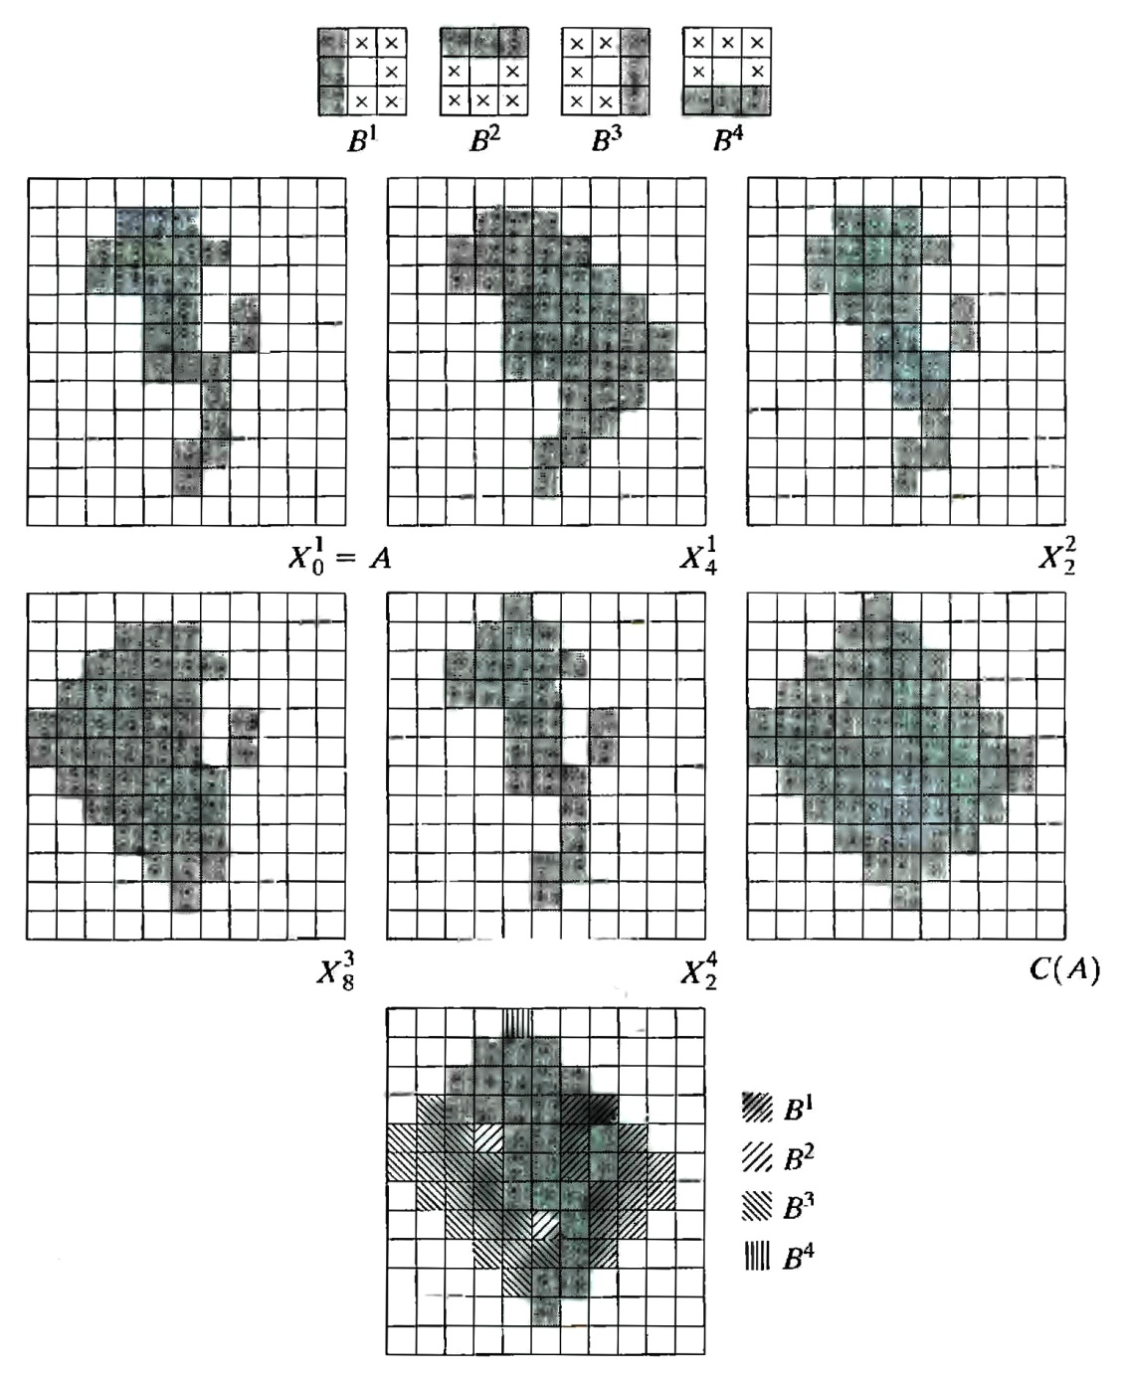

Slide 41
9.5.5 Thinning
The thinning of a set A by a structuring element B, can be defined by terms of the hit-and-miss transform:
A more useful expression for thinning A symmetrically is based on a sequence of structuring elements:
{B}={B¹, B², B³, …, B^{n}}
Where B^{i} is a rotated version of B^{i-1}. Using this concept we define thinning by a sequence of structuring elements:

Slide 42
9.5.5 Thinning cont
The process is to thin by one pass with B¹ , then thin the result with one pass with B², and so on until A is thinned with one pass with B^{n}.
The entire process is repeated until no further changes occur.
Each pass is preformed using the equation:

Slide 43
9.5.5 Thinning example

Slide 44

9.5.6 Thickening
Thickening is a morphological dual of thinning.
Definition of thickening .
As in thinning, thickening can be defined as a sequential operation:
the structuring elements used for thickening have the same form as in thinning, but with all 1’s and 0’s interchanged.

Slide 45
9.5.6 Thickening - cont
A separate algorithm for thickening is often used in practice, Instead the usual procedure is to thin the background of the set in question and then complement the result.
In other words, to thicken a set A, we form C=A^{c} , thin C and than form C^{c}.
depending on the nature of A, this procedure may result in some disconnected points. Therefore thickening by this procedure usually require a simple post-processing step to remove disconnected points.

Slide 46
9.5.6 Thickening example preview
We will notice in the next example 9.22(c) that the thinned background forms a boundary for the thickening process, this feature does not occur in the direct implementation of thickening
This is one of the reasons for using background thinning to accomplish thickening.

Slide 47

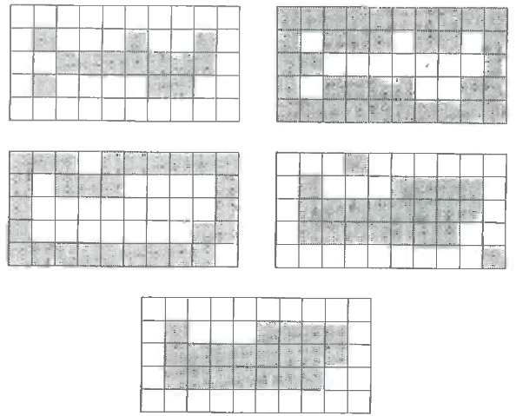

9.5.6 Thickening example

Slide 48
9.5.7 Skeleton
The notion of a skeleton S(A) of a set A is intuitively defined, we deduce from this figure that:
If z is a point of S(A) and (D)z is the largest disk centered in z and contained in A (one cannot find a larger disk that fulfils this terms) – this disk is called “maximum disk”.
The disk (D)z touches the boundary of A at two or more different places.

Slide 49



9.5.7 Skeleton
The skeleton of A is defined by terms of erosions and openings:
with
Where B is the structuring element and indicates k successive erosions of A:
k times, and K is the last iterative step before A erodes to an empty set, in other words:
in conclusion S(A) can be obtained as the union of skeleton subsets Sk(A).

Slide 50

9.5.7 Skeleton Example

Slide 51


9.5.7 Skeleton
A can be also reconstructed from subsets Sk(A) by using the equation:
Where denotes k successive dilations of Sk(A) that is:

